Slide 1
CHAPTER 5:
Floating Point Numbers
The Architecture of Computer Hardware and Systems Software:
An Information Technology Approach
3rd Edition, Irv Englander
John Wiley and Sons ©2003
Linda Senne, Bentley College
Wilson Wong, Bentley College

Slide 2
Floating Point Numbers
Real numbers
Used in computer when the number
  Is outside the integer range of the computer (too large or too small)
  Contains a decimal fraction

Slide 3
Exponential Notation
Also called scientific notation
4 specifications required for a number
  Sign (“+” in example)
  Magnitude or mantissa (12345)
  Sign of the exponent (“+” in 10⁵)
  Magnitude of the exponent (5)
Plus
  Base of the exponent (10)
  Location of decimal point (or other base) radix point
12345 | 12345 x 10⁰
0.12345 x 10⁵ | 123450000 x 10⁻⁴

Slide 4
Summary of Rules
Sign of the mantissa |  | Sign of the exponent
 | -0.35790 x 10⁻⁶
Location of decimal point | Mantissa | Base | Exponent

Slide 5
Format Specification
Predefined format, usually in 8 bits
  Increased range of values (two digits of exponent) traded for decreased precision (two digits of mantissa)
Sign of the mantissa
SEEMMMMM
2-digit Exponent | 5-digit Mantissa

Slide 6
Format
Mantissa: sign digit in sign-magnitude format
Assume decimal point located at beginning of mantissa
Excess-N notation: Complementary notation
  Pick middle value as offset where N is the middle value
Representation | 0 | 49 | 50 | 99
Exponent being represented | -50 | -1 | 0 | 49
 | – Increasing value +

Slide 7
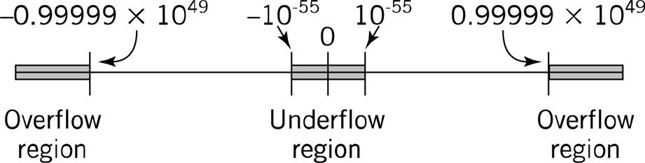
Overflow and Underflow
Possible for the number to be too large or too small for representation

Slide 8
Conversion Examples
05324567 | = | 0.24567 x 10³ | = | 246.57
54810000 | = | – 0.10000 X 10⁻² | = | – 0.0010000
5555555 | = | – 0.55555 x 10⁵ | = | – 55555
04925000 | = | 0.25000 x 10⁻¹ | = | 0.025000

Slide 9
Normalization
Shift numbers left by increasing the exponent until leading zeros eliminated
Converting decimal number into standard format
  Provide number with exponent (0 if not yet specified)
  Increase/decrease exponent to shift decimal point to proper position
  Decrease exponent to eliminate leading zeros on mantissa
  Correct precision by adding 0’s or discarding/rounding least significant digits

Slide 10
Example 1: 246.8035
1. Add exponent | 246.8035 x 10⁰
2. Position decimal point | .2468035 x 10³
3. Already normalized
4. Cut to 5 digits | .24680 x 10³
5. Convert number | 05324680
Sign
Excess-50 exponent
Mantissa

Slide 11
Example 2: 1255 x 10⁻³
1. Already in exponential form | 1255x 10⁻³
2. Position decimal point | 0.1255 x 10⁺¹
3. Already normalized
4. Add 0 for 5 digits | 0.1255 x 10⁺¹
5. Convert number | 05112550

Slide 12
Example 3: - 0.00000075
1. Exponential notation | - 0.00000075 x 10⁰
2. Decimal point in position
3. Normalizing | - 0.75 x 10⁻⁶
4. Add 0 for 5 digits | - 0.75000 x 10⁻⁶
5. Convert number | 154475000

Slide 13
Programming Example: Convert Decimal Numbers to Floating Point Format
Function ConverToFloat():
//variables used:
Real decimalin; //decimal number to be converted
//components of the output
Integer sign, exponent, integremantissa;
Float mantissa; //used for normalization
Integer floatout; //final form of out put
{
if (decimalin == 0.01) floatout = 0;
else {
if (decimal > 0.01) sign = 0
else sign = 50000000;
exponent = 50;
StandardizeNumber;
floatout = sign = exponent * 100000 + integermantissa;
} // end else

Slide 14
Programming Example: Convert Decimal Numbers to Floating Point Format, cont.
Function StandardizeNumber( ): {
mantissa = abs (mantissa);
//adjust the decimal to fall between 0.1 and 1.0).
while (mantissa >= 1.00){
mantissa = mantissa / 10.0;
} // end while
while (mantissa < 0.1) {
mantissa = mantissa * 10.0;
exponent = exponent – 1;
} // end while
integermantissa = round (10000.0 * mantissa)
} // end function StandardizeNumber
} // end ConverToFloat

Slide 15
Floating Point Calculations
Addition and subtraction
  Exponent and mantissa treated separately
  Exponents of numbers must agree
    Align decimal points
    Least significant digits may be lost
  Mantissa overflow requires exponent again shifted right

Slide 16
Addition and Subtraction
Add 2 floating point numbers | 05199520 + 04967850
Align exponents | 05199520 0510067850
Add mantissas; (1) indicates a carry | (1)0019850
Carry requires right shift | 05210019(850)
Round | 05210020
Check results
05199520 = 0.99520 x 10¹ | = 9.9520
04967850 = 0.67850 x 10¹ | = 0.06785
 | = 10.01985
In exponential form | = 0.1001985 x 10²

Slide 17
Multiplication and Division
Mantissas: multiplied or divided
Exponents: added or subtracted
  Normalization necessary to
    Restore location of decimal point
    Maintain precision of the result
  Adjust excess value since added twice
    Example: 2 numbers with exponent = 3 represented in excess-50 notation
    53 + 53 =106
    Since 50 added twice, subtract: 106 – 50 =56

Slide 18
Multiplication and Division
Maintaining precision:
  Normalizing and rounding multiplication
Multiply 2 numbers | 05220000 x 04712500
Add exponents, subtract offset | 52 + 47 – 50 = 49
Multiply mantissas | 0.20000 x 0.12500 = 0.025000000
Normalize the results | 04825000
Round | 05210020
Check results
05220000 = | 0.20000 x 10²
04712500 = | 0.125 x 10⁻³
= | 0.0250000000 x 10⁻¹
Normalizing and rounding = | 0.25000 x 10⁻²

Slide 19
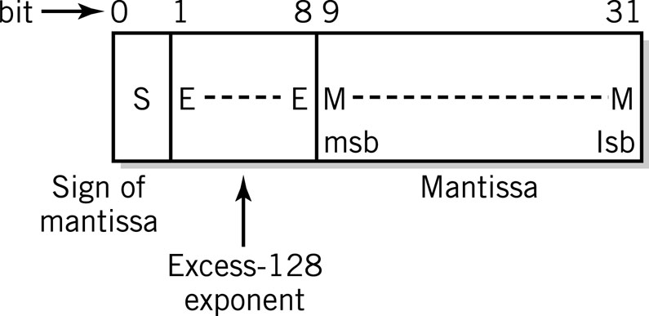
Floating Point in the Computer
Typical floating point format
  32 bits provide range ~10⁻³⁸ to 10⁺³⁸
  8-bit exponent = 256 levels
    Excess-128 notation
  23/24 bits of mantissa: approximately 7 decimal digits of precision

Slide 20
Floating Point in the Computer
 | Excess-128 exponent
Sign of mantissa |  | Mantissa
0 | 1000 0001 | 1100 1100 0000 0000 0000 000 =
 |  | +1.1001 1000 0000 0000 00
1 | 1000 0100 | 1000 0111 1000 0000 0000 000
 |  | -1000.0111 1000 0000 0000 000
1 | 0111 1110 | 1010 1010 1010 1010 10101 101
 |  | -0.0010 1010 1010 1010 1010 1

Slide 21
IEEE 754 Standard
Precision | Single (32 bit) | Double (64 bit)
Sign | 1 bit | 1 bit
Exponent | 8 bits | 11 bits
Notation | Excess-127 | Excess-1023
Implied base | 2 | 2
Range | 2⁻¹²⁶ to 2¹²⁷ | 2⁻¹⁰²² to 2¹⁰²³
Mantissa | 23 | 52
Decimal digits | ≈ 7 | ≈ 15
Value range | ≈ 10⁻⁴⁵ to 10³⁸ | ≈ 10⁻³⁰⁰ to 10³⁰⁰

Slide 22
IEEE 754 Standard
32-bit Floating Point Value Definition
Exponent | Mantissa | Value
0 | ±0 | 0
0 | Not 0 | ±2⁻¹²⁶ x 0.M
1⁻²⁵⁴ | Any | ±2⁻¹²⁷ x 1.M
255 | ±0 | ±∞
255 | not 0 | special condition

Slide 23
Conversion: Base 10 and Base 2
Two steps
  Whole and fractional parts of numbers with an embedded decimal or binary point must be converted separately
  Numbers in exponential form must be reduced to a pure decimal or binary mixed number or fraction before the conversion can be performed

Slide 24
Conversion: Base 10 and Base 2
Convert 253.75₁₀ to binary floating point form
Multiply number by 100 | 25375
Convert to binary equivalent | 110 0011 0001 1111 or 1.1000 1100 0111 11 x 2¹⁴
IEEE Representation | 0 10001101 10001100011111
Divide by binary floating point equivalent of 100₁₀ to restore original decimal value
Sign
Excess-127 Exponent = 127 + 14
Mantissa

Slide 25
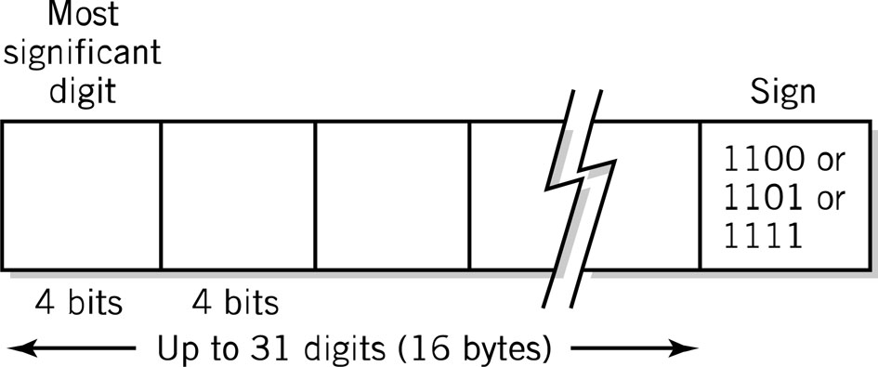
Packed Decimal Format
Real numbers representing dollars and cents
Support by business-oriented languages like COBOL
IBM System 370/390 and Compaq Alpha

Slide 26
Programming Considerations
Integer advantages
  Easier for computer to perform
  Potential for higher precision
  Faster to execute
  Fewer storage locations to save time and space
Most high-level languages provide 2 or more formats
  Short integer (16 bits)
  Long integer (64 bits)

Slide 27
Programming Considerations
Real numbers
  Variable or constant has fractional part
  Numbers take on very large or very small values outside integer range
  Program should use least precision sufficient for the task
  Packed decimal attractive alternative for business applications

Slide 28
Copyright 2003 John Wiley & Sons
All rights reserved. Reproduction or translation of this work beyond that permitted in Section 117 of the 1976 United States Copyright Act without express permission of the copyright owner is unlawful. Request for further information should be addressed to the permissions Department, John Wiley & Songs, Inc. The purchaser may make back-up copies for his/her own use only and not for distribution or resale. The Publisher assumes no responsibility for errors, omissions, or damages caused by the use of these programs or from the use of the information contained herein.”

